Slide 1
Group Germany_task
Yunzhou Feng
Ziyang jiang
Jingyu su
Weining chen
Kecheng li

Slide 2
User Research Results
FOCUS: anxiety & depression
IMPACT OF SURROUNDINGS ON PATIENTS: social contacts, friend, friends, listeners
DESIGN: communication methods, simple design, trained professionals, safety, privacy
SERVICE: one question, assessment, clinics, language, listeners
PEOPLE’S ATTITUDE TOWARDS PSYCHOLOGICAL ASSITANCE: not positive
DISADVANTAGE OF TRADITIONAL PSYCHOLOGICAL TREATMENT: cost, time, language, shortage
REASON WHY MENTAL HEALTH CHALLENGE: work, family, relationship, study
DISADAVANTAGE OF ONLINE PSYCHOLOGICAL TREATMENT: legality, not face-to-face, trust
Notes:
FOCUS:
focus on anxiety and depression
Depression is very common but serious illness
IMPACT OF SURROUNDINGS ON PATIENTS:
need of social contact
people are willing to help friends
people who do not want to tell closed one about their depression would like to talk to a stranger about it
friends can participate in offline cure
listener: trained peer counselors
male do not mind friends know about their mental problem while female do not mind family know about their mental problem: provide choices for offline cure
DESIGN:
favorite way to do consultation: face-to-face > phone > message > E-mail, not letter or video chat
Prefer message communication with doctors at the beginning, and face-to-face in further treatment
simple design: not mental-health-specific
training is essential, when a psychologist shift from face-to-face counseling to online counselling, certain training is required
users’ privacy and website safety are the most important
SERVICE:
ask one question and pay a little bit for a respond from a professional
online psychological assessment
collaborating with existed clinics
choice of language
online therapy is suitable for psychotherapy in the early stage
online psychological assessment
listener: trained peer counselors
PEOPLE’S ATTITUDE TOWARDS PSYCHOLOGICAL ASSITANCE:
people still don't really understand what is mental health
most students think that mental health supports should available for them whenever needed.
People don’t treat it as the first choice.
Students are more likely to search for help than young workers, but young workers would like to pay more time and money when necessary
Mostly people do not want to use an app about psychological assistance
DISADVANTAGE OF TRADITIONAL PSYCHOLOGICAL TREATMENT:
cost of people going to see the psychologist is very expensive
the appointment takes so much time
language barrier
Campus psychological supports can’t fulfill the demand for students.
MOST COMMON REASON TO HAVE MENTAL HEALTH CHALLENGE:
Most students facing mental challenge related to future employment. Their way of releasing stress is to shift attention and back to work later.
Students gain pressure mainly in study, while young workers more in family issues and the conflict between family and working (balancing)
Young professionals may confront more problems in working if they expose to others that they have mental health issues (e.g. may not continue to be hired), so they’ll try to hide their problems and thus avoid face-to-face treatment; students have less concerns on it and more willing to have face-to-face treatment)
DISADAVANTAGE OF ONLINE PSYCHOLOGICAL TREATMENT:
lack of legal protection
not face-to-face
trust issue

Slide 3
User needs list
Will:
keep daily post (short diary)
think positive
sharing happiness
interact with friends
Won’t: anything else
Notes:
Since we change the big picture of our project, most of the results from the research will be used as reference but not addressed in the system.

Slide 4
Stakeholders and impact on them
Users: think more positive, be happier,
Friends: share happiness and have closer ties to friends by helping and encouraging each other
Family: have chance to know about other family members’ situation and help them, support them
Administrator: gain plentiful positive energy

Slide 5
Primary personas:
people who feel slightly depressed, unhappy or negative, and they want to be/keep positive or make a change.
Scenarios:
A girl who just breaks up with her boyfriend and feels very sad and she wants to use the app to get help and encouragement.
People who are on a new stage of their life feel panic, loss and nervous. They need some support and positive energy to help them get everything back on track from the app.
Parents have depressed kids and want to help them and know about them. They expect the app can help them.

Slide 6
Design requirements
Problem: help people think positive
Design principles: less functions, neat, clean, easy to understand and use
Measure of success:
willingness to recommend to friends
share on social networks
downloads
share on social media
comment rate
use frequency
duration of usage
Registrations
average posts

Slide 7
Environmental requirements
Internet access
Mobile devices
Ability to read & type
Functional requirements
Post happy thoughts, experience, etc (short diary)
Comment, like, follow, share
Personal profile & home page
Authentication & authorization (registration)
Administration
Search & recommendation
Notification
Setting
Technical requirements
Privacy protection
Database
Memory support
Responding speed (performance)
Programming language
Responsive web design
Operating environment
Screen on the device
Internet access
Usability requirements
Ability to read and type
Have mobile devices and know how to use it
Incentive for sharing

Slide 8

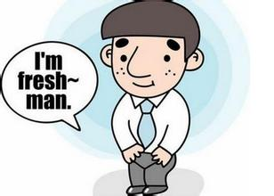
SHORT FORM CREATIVE BRIEF
Project Objective: Encourage and lead people to discover and record their happiness in daily lives, and create a supportive social environment for them.
Key principle: confidentiality
Straight-A Ben Freshman Sam
Notes:
Key Persona:
Ben - 20 years old student of u of t, who is studying in apply math. He is studying very hard but very easy to get stress when the workload is intense. (Depress)
Sam - 23 years old new employee who is working at IBM technical support group. He is not very used to his working pace. (Negative thought)
Key Scenarios:
Ben was having two large assignments within one month. He worked very hard for these assignments. However, in the last 30 minutes of first deadline, he fell to sleep and failed to submit the assignment. He felt so depressed and lose confidence to continue the other assignment.
Sam has newly graduated from university and got the job at IBM. As a new graduated he find out he still has so many things has to learn in the new environment, it caused him run out of time to finish his own task. He felt very helpless.
Key Principle:
The design should respect the confidentiality of customer information unless getting permissions from the customers.

Slide 9
Experience Map

Slide 10
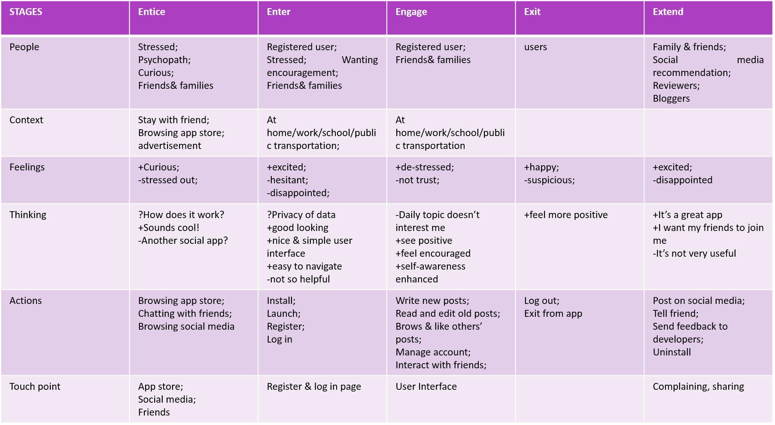

Slide 11
Plans for Individual Low Fi Prototypes & Usability Testing
Personal Profile – Jingyu Su
Post – Ziyang Jiang
Moment – Yunzhou Feng
Recommendation – Kecheng Li
First-login page, introduction and friend search – Weining Chen

